Slide 1




Introduction to Flight Fare Prediction
This presentation provides an overview of using python to predict flight fares. We'll cover from data collection to model deployment, highlighting key techniques and insights along the way.
by Kavin V

Slide 2

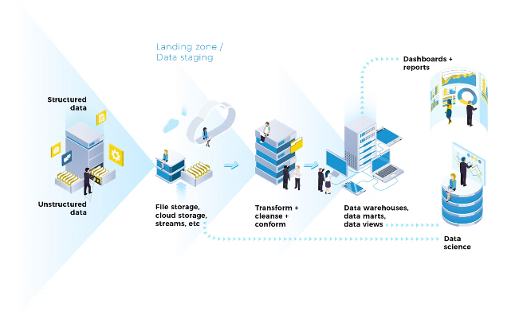
Data Collection and Preprocessing
1
Data Sources
Gather historical flight pricing data from various online sources to create a comprehensive dataset.
2
Data Cleaning
Clean and preprocess the data, handling missing values, outliers, and inconsistencies.
3
Feature Engineering
Extract relevant features from the raw data to prepare it for analyzing and to make inferences.

Slide 3
Feature Engineering
Flight Attributes
Boarding Type
Ticket Fare
Engineer features like departure/arrival times, flight duration, number of stops, and airline.
Incorporate passenger information such as class, duration, and days left.
Include flight fare for various airlines by price of tickets in booking time.

Slide 4

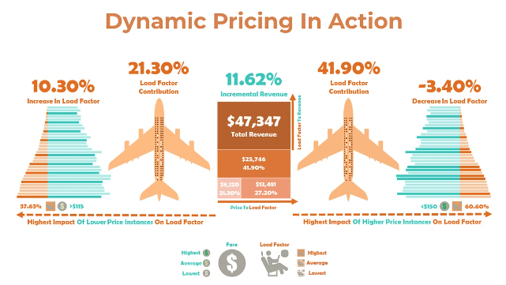
Exploratory Data Analysis
1
Price Trends
2
Feature Relationships
Analyze historical flight price patterns and identify
difference.
Investigate the correlations between flight attributes and ticket prices.
3
Market Segmentation
Categorize ticket price based on factors like different airlines and duration of travel time.

Slide 5
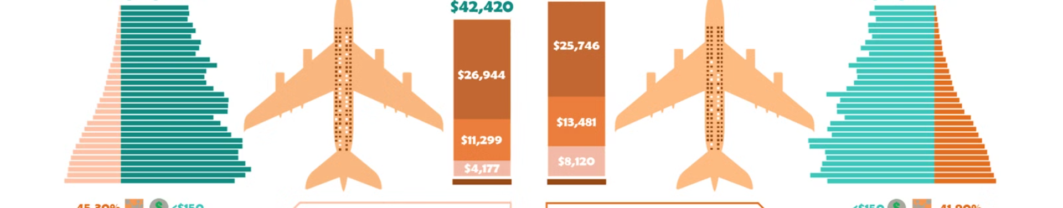
Conclusion and Future Improvements
Improved Accuracy
Incorporate additional data sources and advanced modeling techniques to enhance prediction accuracy.
Dynamic Pricing
Develop a system that adjusts flight fares based on real-time market conditions and customer behavior.
Personalization
Leverage machine learning to provide personalized flight recommendations and pricing for individual customers.

